Slide 1
Fake News Classifier
Submitted by:
Avinash singh

Slide 2
Project Details
Project Source : Flip Robo Technologies
Mentor : Nitin Mishra
Guidelines Source : Youtube, Medium, web
Platforms : Google Colab
Libraries :NLTK, Pandas, Matplotlib, Seaborn, Sklearn

Slide 3
Fake -News Detection Project
Problem statement:
The authenticity of Information has become a longstanding issue affecting businesses and society, both for printed and digital media. On social networks, the reach and effects of information spread occur at such a fast pace and so amplified that distorted, inaccurate, or false information acquires a tremendous potential to cause real-world impacts, within minutes, for millions of users. Recently, several public concerns about this problem and some approaches to mitigate the problem were expressed.

Slide 4
Data Preprocessing
The first step in the data pre-processing is to obtained the whole information about the dataframe including the index datatype, row and columns, non-null values and memory usage.
As given dataset is a text data and there is null value so we have to drop null value because managing it is not a proper task.
Concatenating two main input feature and create a new features “News”.
Dropping Unnamed: 0,id,written_by,headline,news column because it does not give any predictive information and also dropping null value.
Removing all frequent words and string punctuations so that dataset will only hold importance token.
Word embedding techniques of TF-IDF is applied to the text features to convert the text to the vector form.

Slide 5
PERFORMANCE METRICS
The most important metrics to be taken into consideration are as follows:
F1-Score
Precision
Recall
ROC-AUC Curve

Slide 6
Algorithms Used
Following are the algorithms that is applied on this dataset:
Logistic Regression
GaussianNB
DecisionTreeClassifier
RandomForestClassifier

Slide 7
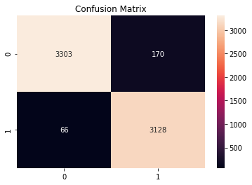
Best Model Performance
Score of Random Forest Classifier after hyper parameter tuning:
Accuracy = 0.964
Precision = 0.948
Recall = 0.979
F1 Score = 0.963

Slide 8
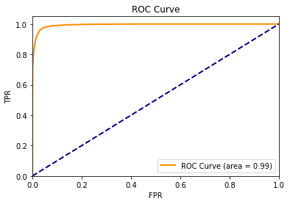
ROC-AUC GRAPH OF BEST MODELS

Slide 9
Thank you

